Slide 1



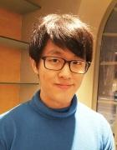
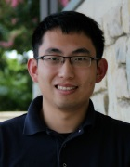
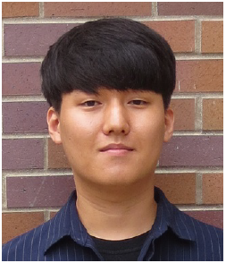
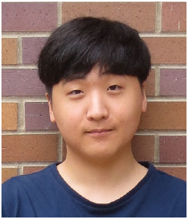
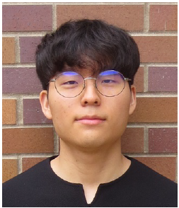

Security Implications
of Compressed Neural Networks
for Self-Driving Cars
Prof. Sang Woo Jun
Prof. Qi Alfred Chen
Donghak Park
Woolim Cho
Donghyeon Choi
Notes:
Hello Today we will introduce about Security implications of compressed neural networks for self-driving cars.
My team is consis with Professor Sang Woo Jun and Professor Qi Alfred Chen. and consist of 3 fellowers 조우림, 최동현, 박동학.
‹#›

Slide 2
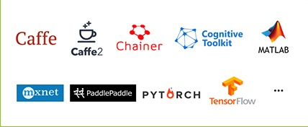
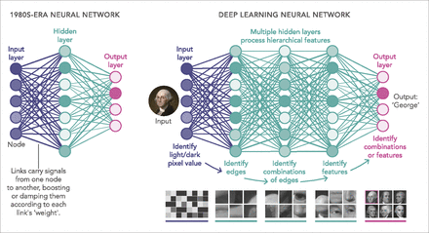
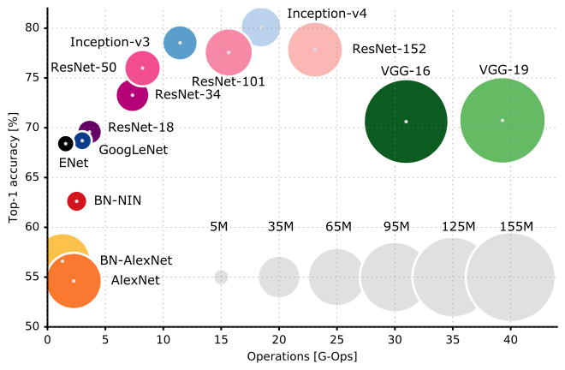
Introduction - Deep Learning, Neural Network
Frame Work
Model
Notes:
First, I will give you a brief description of the Neural Network
Neural Network usually consists of an input layer, output layer and hidden layer
in image recognition
input layer identify light/dark pixel values and hidden layer identify edge, and feature then output layer identify image
There are various frameworks in the natural network, such as caffe, tensorflow,
and there are also various models such as vgg and resnet
using these thing, we can create a deep learning model for each purpose
‹#›

Slide 3
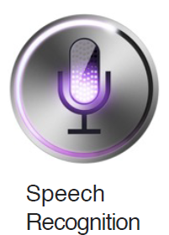

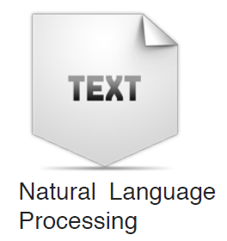
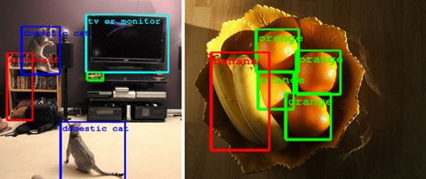
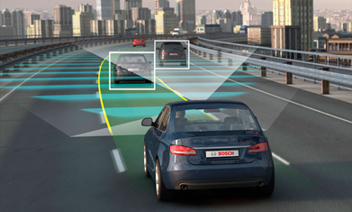
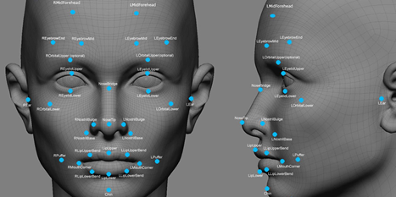
Introduction - Application
Notes:
These deep learning can be used in various areas
such as voice recognition, image recognition and natural language processing
our team focused mainly on images such as self- driving car and object detection as shown below.
‹#›

Slide 4
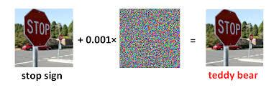
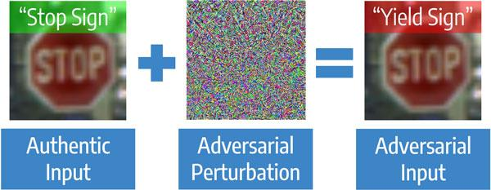
Attack Vulnerability
Vulnerable to
Adversarial Attack
from Malicious Attacker
Notes:
We focused on two issues in the research.
The first is that the neural network in image recognition is vulnerable to attack.
As shown in the picture,
an attacker can cause a stop sign to be recognized as a teddy bear or yield sign in self-driving car by giving constant noise.
These attacks cause serious accidents in practical use.
and these attacks known as a Adversarial Attack
‹#›

Slide 5
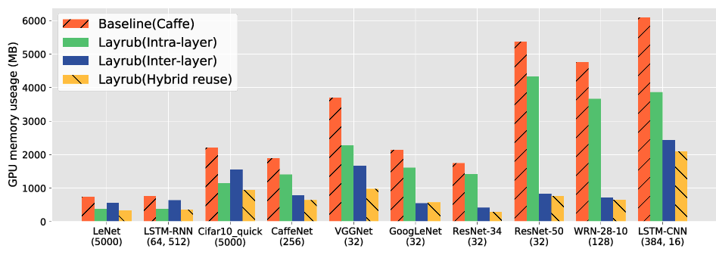
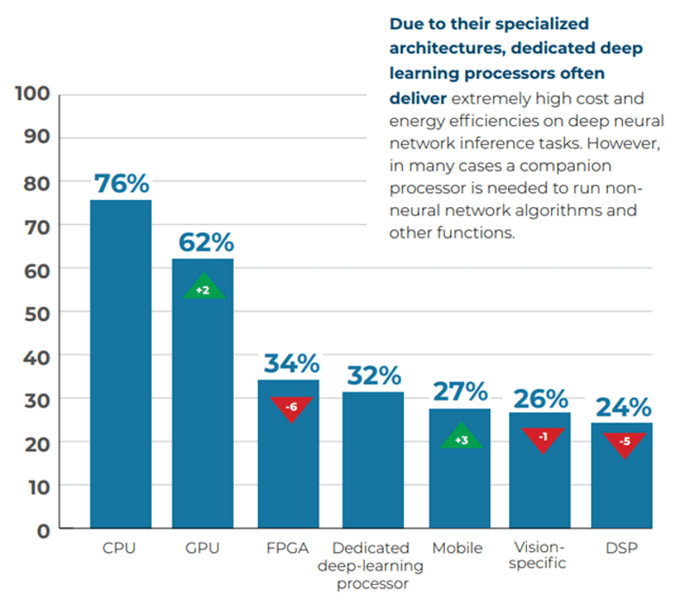
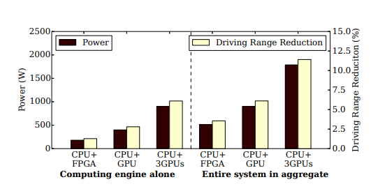
Energy Efficiency, Memory Efficiency
For proper application
1. Reduce Energy usage
2. Compress Model
Notes:
The second issue is energy efficiency and memory efficiency.
As shown in the table below, the deep learning model requires a lot of memory and energy.
These features make it difficult to fit into a mobile device or car.
each table show that as deep learning model’s memory and energy requirements is going up
For proper application we need Reduce Energy usage and we should compress Model
‹#›

Slide 6
Our Research Goal
Deep Learning Model
Lower Energy
consumption
More Robust
from attack
High performance
Defensive
Quantization
Pruning
Zfp
Adversarial Training
Notes:
So the goal of our research is to make our own model
our model require 3 features
1. Low energy consumption
2. Robust model for attack
3. High performance.
To do this, we tried Defensive Quantization, Pruning, Zfp and Adversarial Training
Next, Woollim will continue to explain about these attempts.
‹#›

Slide 7
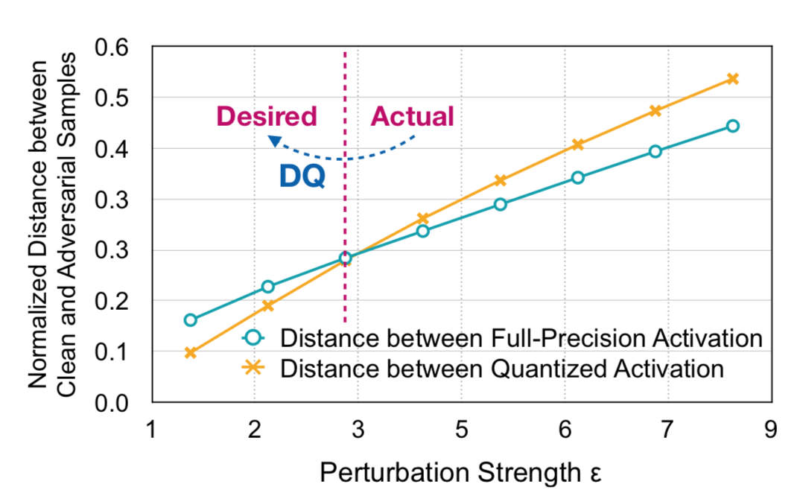
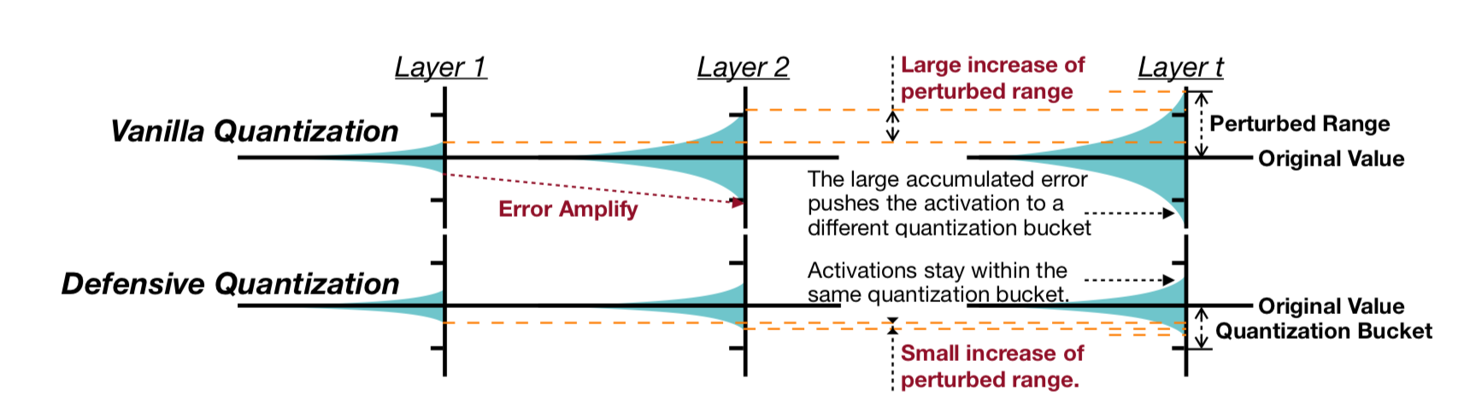
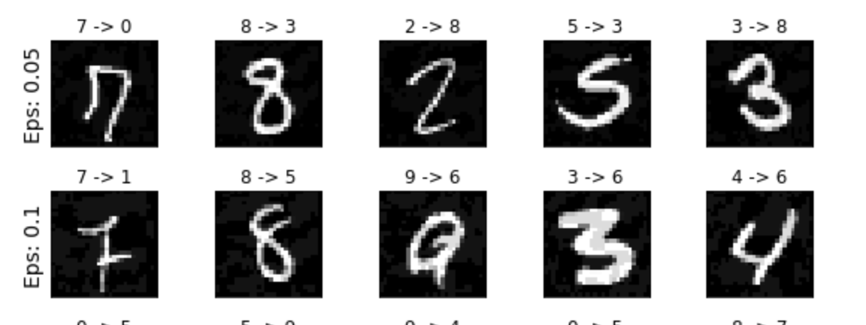
Defensive Quantization
Lipschitz Regularizer
Adversarial Training
Quantization
1.234 => 1.25 (4byte to 4bit)
(Defensive Quantization,Ji Lin et al, 2019)
Notes:
From now on, I will explain our methods this in the project.
We tried to reproduce results from the preliminary studies, especially from paper “Defensive Quantization”.
There are 3 main ideas to make the neural network more robust.
First one is quantization, which converts floating numbers into low bit representation numbers.
For example, we can convert 1.2384 to 1.25 by reducing representation bits.
Not only quantization can make model more light by compressing numbers, but also it makes more robust to small perturbation.
Look at this graph, the authors of the paper did an experiment about effect due to strength of perturbation, and they found that the quantized models are vulnerable to larger perturbation.
However, when the perturbations is small, it was better than the full-precision model.
The problem is, quantized models are vulnerable to large perturbation
To solve this, we should decrease distance between clean and adversarial samples and move model into desired area in the graph.
And this can be done by Lipschitz regularizer.
When we use Lipschitz regularizer, it makes the neural network more insensitive to change of input images, and it has the same effect that reduces distance of clean and adversarial samples.
As a result, quantization and Lipschitz regularizer make a synergy effect, which reduces error amplification in the model.
Last one is adversarial training.
These are adversarial samples that we made.
Please look at the bottom right sample, it seems 4 to human eyes obviously but it is misclassified as 6 because the neural network does not work the same as human brains.
To solve this, we can use adversarial training, literally means that we add adversarial samples to training data, which works like the vaccine to human.
By using these strategies, we can make the neural network model more robust.
‹#›

Slide 8
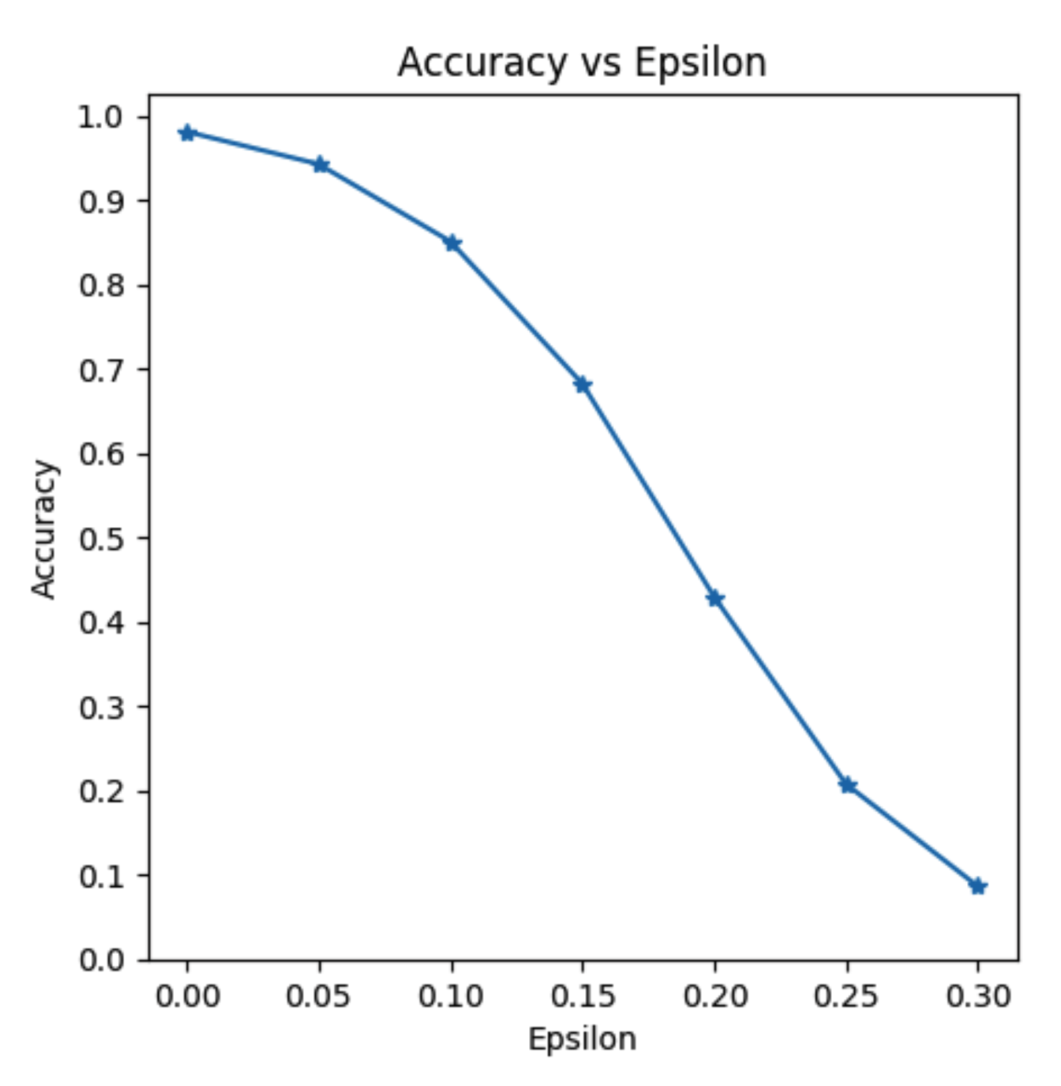
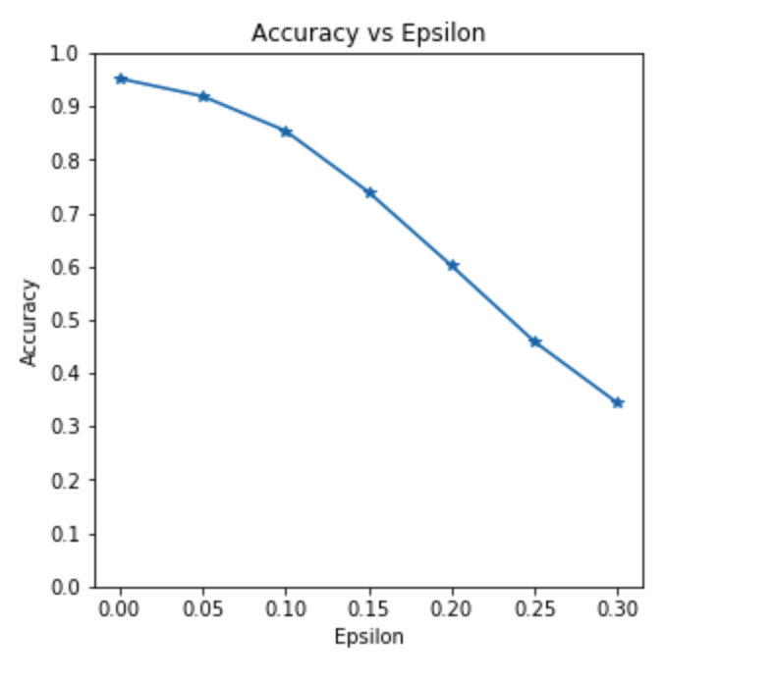
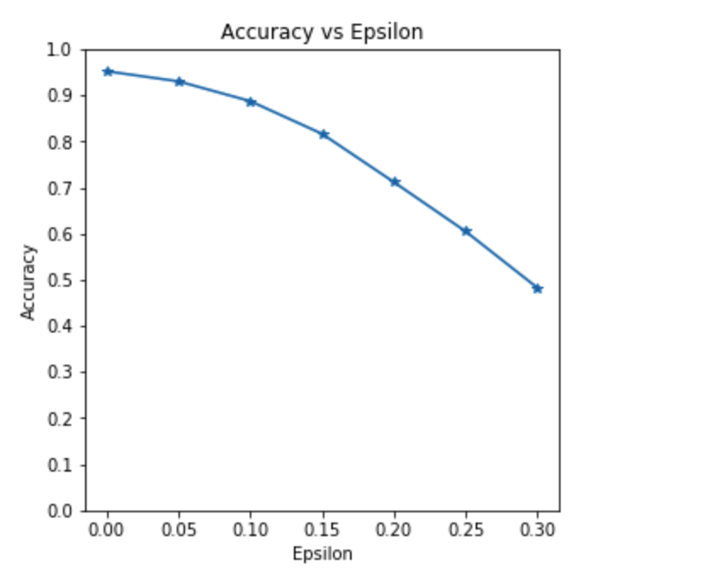
Defensive Quantization
LeNet, MNIST
Original
Lipschitz Regularizer
Adversarial Training
with Lipschitz Regularizer
Notes:
These are results from our experiment.
We used LeNet model and MNIST dataset to evaluate performance.
When we used original settings, the model was very vulnerable to adversarial samples.
Especially, when perturbation strength epsilon was 0.30, it had a lower accuracy than random policy, which is very bad.
However, when we applied lipschitz regularizer and adversarial training, the model showed us improved accuracy compared to original settings.
These results show the strategies from the paper really works and we can use these strategies to our implementation.
‹#›

Slide 9
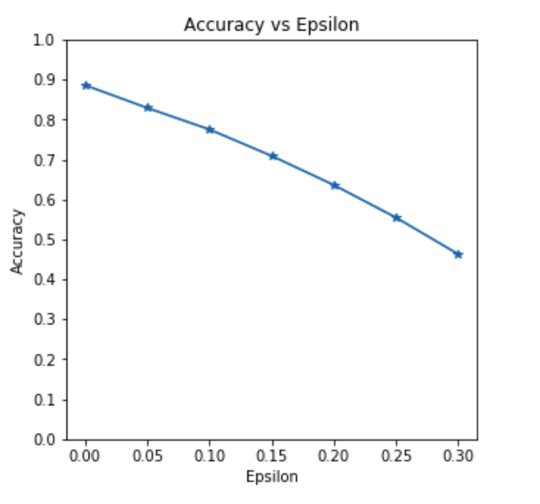
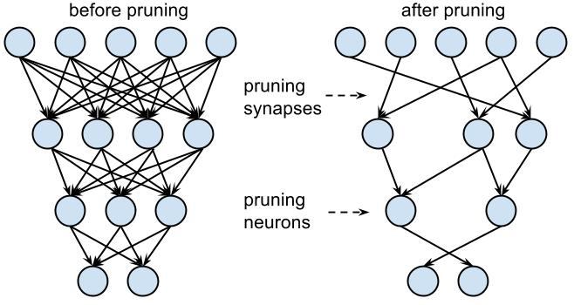
Pruning + Adversarial Training
96% Pruned VGG16

Slide 10
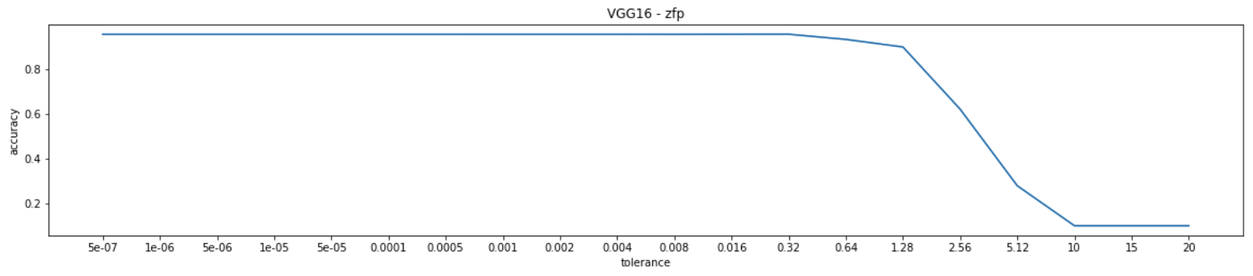
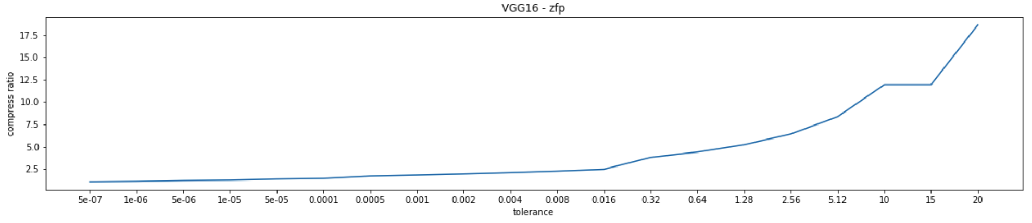
ZFP - Quantization
Weight Clipping
w = min(1.0, max(-1.0, w))
Floating Point
Sign
Exp
Mantissa
Notes:
These are results from our experiment.
We used LeNet model and MNIST dataset to evaluate performance.
When we used original settings, the model was very vulnerable to adversarial samples.
Especially, when perturbation strength epsilon was 0.30, it had a lower accuracy than random policy, which is very bad.
However, when we applied lipschitz regularizer and adversarial training, the model showed us improved accuracy compared to original settings.
These results show the strategies from the paper really works and we can use these strategies to our implementation.
‹#›

Slide 11
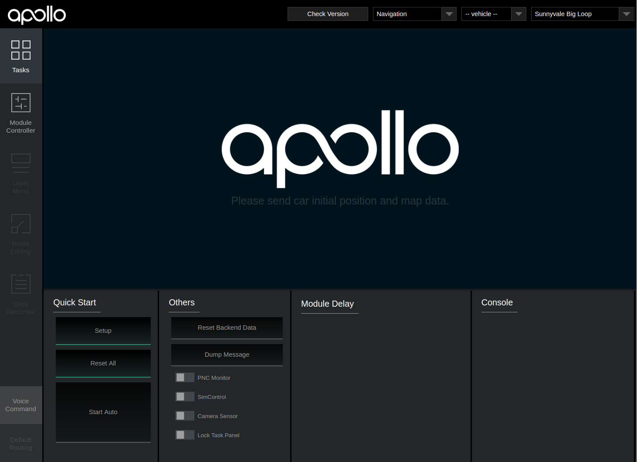
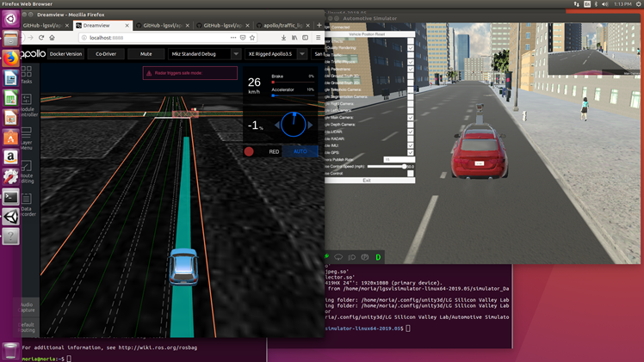
Apollo
Apollo is a high performance, flexible architecture which accelerates the development, testing, and deployment of Autonomous Vehicles.
Notes:
in short, our goal is to design compressed deep learning model with high performance using compression technology in self-driving car.
So we used Apollo to achieve our goal.
Apollo is a high performance, flexible architecture which accelerates the development, testing, and deployment of Autonomous Vehicles.
so We will carry out various experiments through Apollo.
‹#›

Slide 12
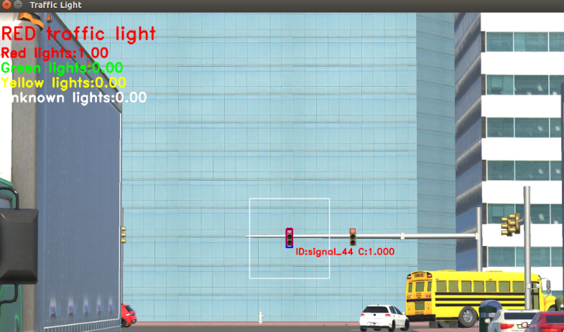
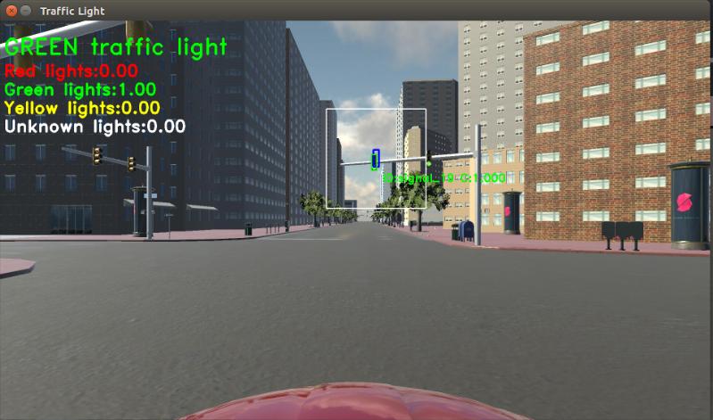
Simulator
Notes:
Let me introduce about the simulator.
This simulator is a virtual environment in which multiple information is used to drive autonomously.
for example, there is function that is to detect traffic light using deep learning and camera data.
and there are many these functions.
so the deep learning model we have to improve include lane detection models, traffic light detection and recognition models and object detection models.
‹#›

Slide 13
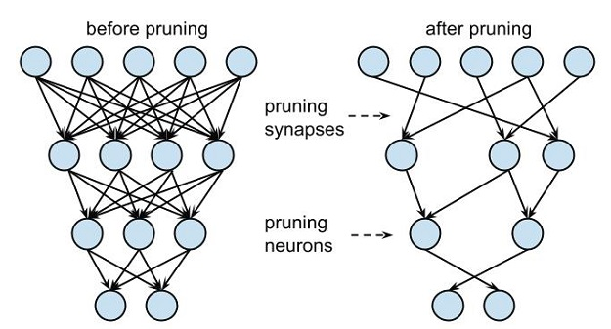
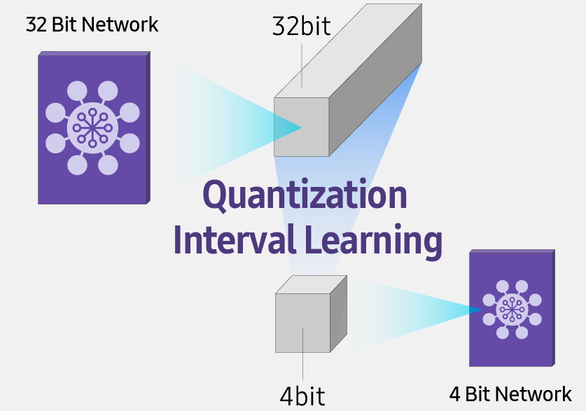
Experiment
Pruning
Quantization
Notes:
We will use the pruning and quantification as compression technologies.
‹#›

Slide 14
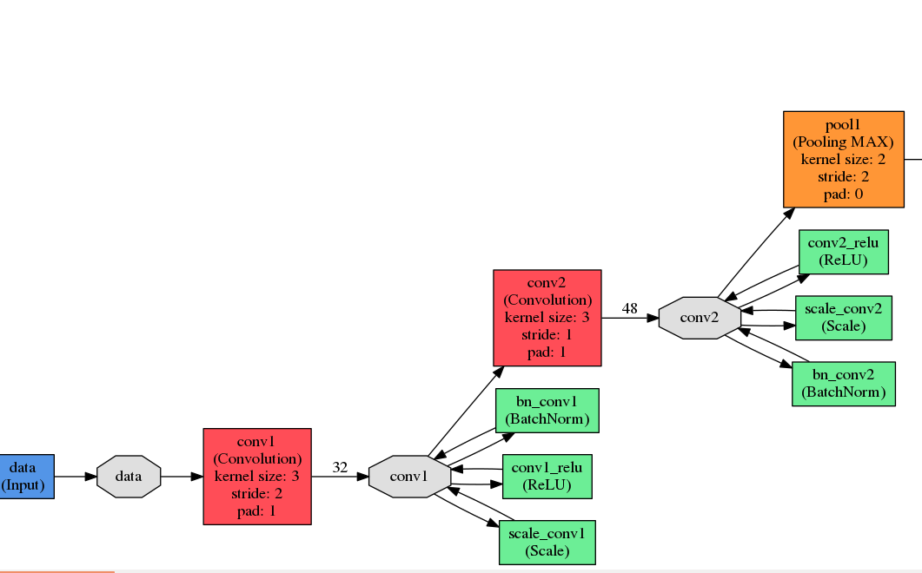
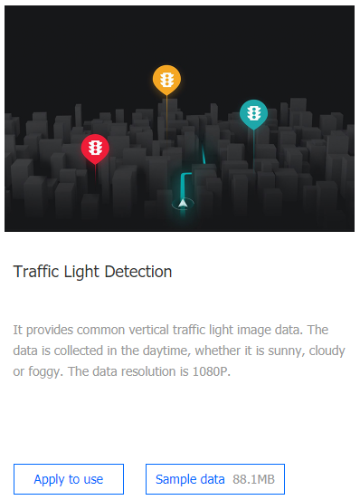
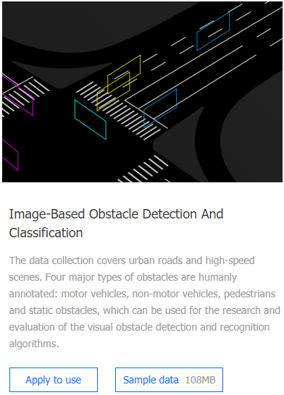
Experiment - abstract
Notes:
We will test the deep learning model using the data set provided by apollo.
The picture on the right is part of the model graphs we are trying to improve.
It is all about our experiment to compress the weight into the layers on the graph.
‹#›

Slide 15
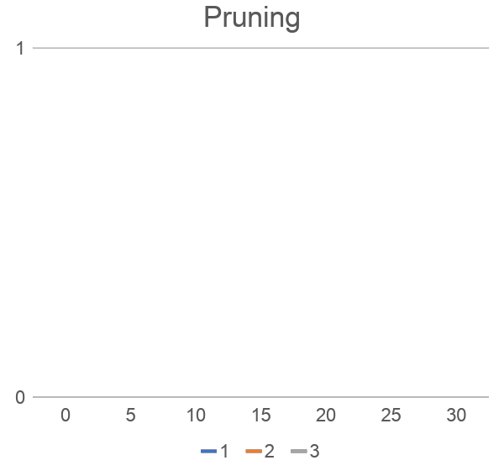

Experiment - Pruning
Accuracy
(Threshold)
Notes:
Let me explain about the Pruning experiment.
Pruning assumes a low absolute value of weight is a useless
and It is a way to delete the weight that is lower than a specific threshold.
so We're completing the graph on the right.
‹#›

Slide 16
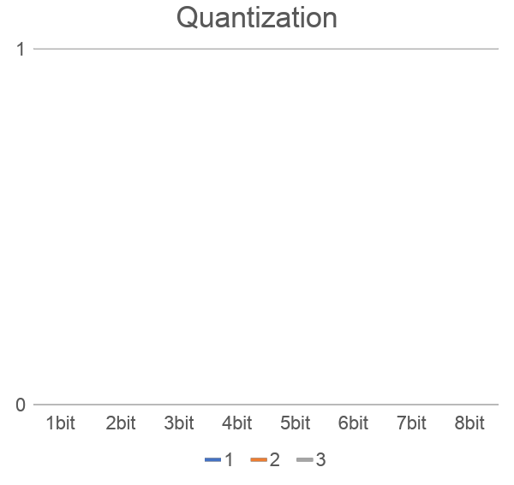
Experiment - Quantization
Accuracy
(weight bit)
Notes:
and Let me explain the quantification experiment.
Quantization is the compression of the range of the weight
so We're completing the graph on the right.
and We will also combine several compression techniques to create multiple graphs. And through this graph, we will design the deep learning model that we want.
‹#›

Slide 17
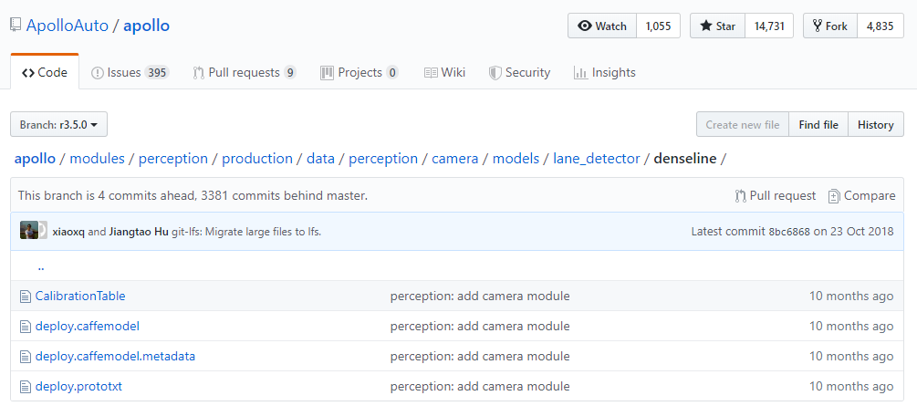
Experiment - Apply
Notes:
Then we will apply the model we created to the simulator.
this is the basic model of Apollo.
if We change that model to our model Then the simulator will work using our model.
so we can visually make sure our model work well
‹#›

Slide 18
Future work
We will complete the graph for the deep learning model compression such as quantization graph and pruning graph and so on.
Through the graph, we will find the maximum compression rate to maintain accuracy.
Notes:
let me introduce about our future work
first We will complete the graph for the deep learning model compression such as quantization graph and pruning graph and so on.
second Through the graph, we will find the maximum compression rate to maintain accuracy
‹#›

Slide 19
Thank you!
Q&A
Notes:
Thank you!
‹#›

